Slide 1
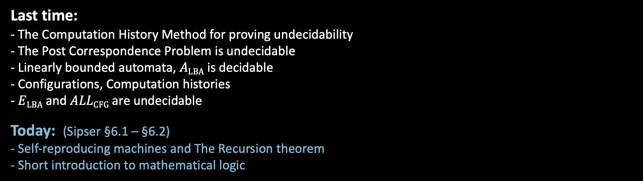
18.404/6.840 Lecture 11
Last time: - The Computation History Method for proving undecidability
- The Post Correspondence Problem is undecidable
- Linearly bounded automata, $A\text{LBA}$ is decidable
- Configurations, Computation histories
- $E\text{LBA}$ and $ALL\text{CFG}$ are undecidable
Today: (Sipser §6.1 – §6.2) - Self-reproducing machines and The Recursion theorem
- Short introduction to mathematical logic
1

Slide 2
Midterm exam
90 minutes length + 20 minutes for printing/scanning/uploading.
Open book, postings, piazza, notes, and lecture videos, from this year.
Covers through Recursion Theorem presented today. Will not include section on mathematical logic.
Not permitted: Communication with anyone except course staff, other materials, internet searching.
Not permitted: Providing information about the exam to anyone who hasn’t completed it.
Please respect our honor system.
2

Slide 3

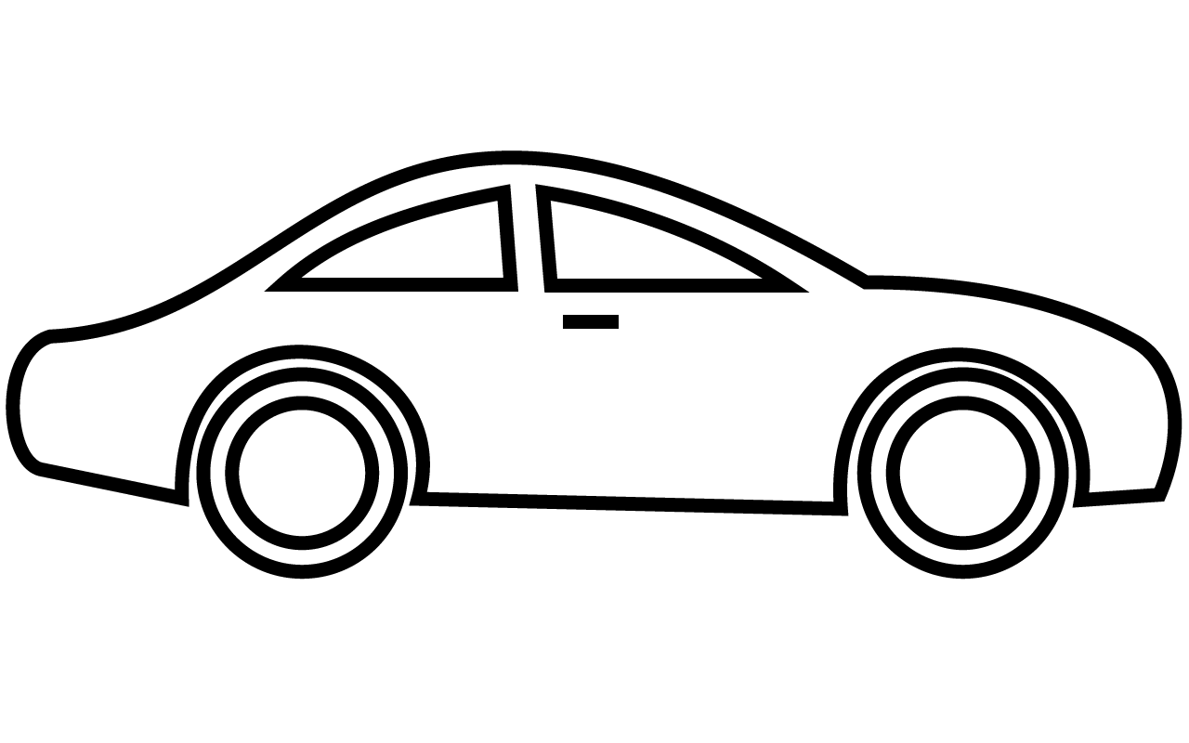

Self-reproduction Paradox
Suppose a Factory makes Cars
- Complexity of Factory > Complexity of Car
(because Factory needs instructions for Car + robots, tools, … )
Can a Factory make Factories?
- Complexity of Factory > Complexity of Factory?
- Seems impossible to have a self-reproducing machine
But, living things self-reproduce
How to resolve this paradox?
Self-reproducing machines are possible!
© Source unknown. All rights reserved. This content is excluded from our Creative Commons license. For more information, see https://ocw.mit.edu/fairuse.
3

Slide 4










A Self-Reproducing TM
Theorem: There is a TM $SELF$ which (on any input) halts with $〈SELF〉$ on the tape.
Lemma: There is a computable function $q:Σ^{∗}→Σ^{∗}$ such that $q\left(w\right)=〈P_{w}〉$ for every $w$, where $P_{w}$ is the TM $P_{w}=$“Print $w$ on the tape and halt”.
Proof: Straightforward.
Proof of Theorem: $SELF$ has two parts, $A$ and $B$.
$A=$ $P_{〈B〉}$
$B=P_{〈A〉}$ ? NO, would be circular reasoning.
$B=$ “1. Compute $q$(tape contents) to get $A$.
2. Combine with $B$ to get $AB=SELF$.
3. Halt with $〈SELF〉$ on tape.”
$$A$$
$$B$$
$$〈B〉$$
$$〈AB〉=〈SELF〉$$
$$P_{〈B〉}$$
Compute $A=P_{〈B〉}$ from $B$ on tape.
$$SELF$$
Can implement in any programming language.
4

Slide 5





English Implementation
Check-in 11.1
Implementations of the Recursion Theorem have two parts, a Template and an Action. In the TM and English implementations, which is the Action part?
A and the upper phrase
A and the lower phrase
B and the upper phrase
B and the lower phrase.
Write “Hello World”
Hello World
Write this sentence
Write this sentence
Write the following twice, the second time in quotes “Hello World”
Hello World “Hello World”
Write the following twice, the second time in quotes “Write the following twice, the second time in quotes” Write the following twice, the second time in quotes “Write the following twice, the second time in quotes”
Cheating: TMs don’t have this self-reference primitive.
$$A$$
$$B$$
$$〈AB〉$$
$$P_{〈B〉}$$
Compute $A=P_{〈B〉}$ from $B$ on tape.
$$SELF$$
Note on Pset Problem 6: Don’t need to worry about quoting.
5
Check-in 11.1

Slide 6




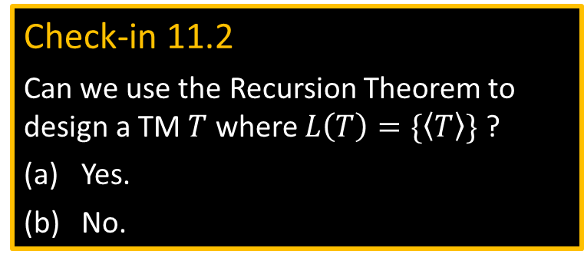







The Recursion Theorem
A compiler which implements “compute your own description” for a TM.
Theorem: For any TM $T$ there is a TM $R$ where for all $w$ R on input $w$ operates in the same way as $T$ on input $〈w, R〉$.
$$R$$
Proof of Theorem: $R$ has three parts: $A$, $B$, and $T$.
$T$ is given
$A=$ $P_{〈BT〉}$
$B=$ “1. Compute $q$(tape contents after $w$) to get $A$.
2. Combine with $BT$ to get $ABT=R$.
3. Pass control to $T$ on input $〈w, R〉$.”
$$A$$
$$B$$
$$T$$
$$w$$
$$〈ABT〉=R$$
$$〈BT〉$$
$$P_{〈BT〉}$$
Compute $A$ from tape
Check-in 11.2
Can we use the Recursion Theorem to design a TM $T$ where $L\left(T\right)=\{〈T〉\}$ ?
Yes.
No.
Moral: You can use “compute your own description” in describing TMs.
6
Check-in 11.2

Slide 7


Ex 1: $A\text{TM}$ is undecidable - new proof
Theorem: $A\text{TM}$is not decidable
Proof by contradiction: Assume some TM $H$ decides $A\text{TM}$.
Consider the following TM $R$:
$R=$ “On input $w$
1. Get own description $〈R〉$.
2. Use $H$ on input $〈R,w〉$ to determine whether $R$ accepts $w$.
3. Do the opposite of what $H$ says.”
7

Slide 8

Ex 2: Fixed-point Theorem
Theorem: For any computable function $f:Σ^{∗}→Σ^{∗}$, there is a TM $R$ such that $L\left(R\right)=L(S)$ where $f\left(〈R〉\right)=〈S〉$.
In other words, consider $f$ to be a program transformation function. Then for some program $R$, its behavior is unchanged by $f$.
Proof: Let $R$ be the following TM.
$R=$ “On input $w$
1. Get own description $〈R〉$.
2. Compute $f\left(〈R〉\right)$ and call the result $〈S〉$.
3. Simulate $S$ on $w$.”
8

Slide 9


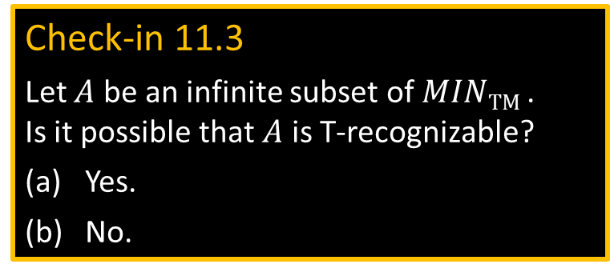
Ex 3: $MIN\text{TM}$ is T-unrecognizable
Defn: $M$ is a minimal TM if $\left|〈M^{′}〉\right|<\left|〈M〉\right|→L\left(M^{′}\right)≠L(M)$.
Thus, a minimal TM has the shortest description among all equivalent TMs.
Let $MIN\text{TM}$ $=\left\{〈M〉\right| M$ is a minimal TM$\}$. Theorem: $MIN\text{TM}$ is T-unrecognizable.
Proof by contradiction: Assume some TM $E$ enumerates $MIN\text{TM}$ .
Consider the following TM $R$:
$R=$ “On input $w$
1. Get own description $〈R〉$.
2. Run enumerator $E$ until some TM $B$ appears, where $\left|〈R〉\right|<\left|〈B〉\right|$.
3. Simulate $B$ on $w$.”
Thus $L\left(R\right)=L(B)$ and $\left|〈R〉\right|<\left|〈B〉\right|$ so $B$ isn’t minimal, but $〈B〉∈L(E)$, contradiction.
Check-in 11.3
Let $A$ be an infinite subset of $MIN\text{TM}$ . Is it possible that $A$ is T-recognizable?
Yes.
No.
9
Check-in 11.3

Slide 10
Other applications
Computer viruses.
A true but unprovable mathematical statement due to Kurt Gödel: “This statement is unprovable.”
10

Slide 11

Intro to Mathematical Logic
Goal: A mathematical study of mathematical reasoning itself.
Formally defines the language of mathematics, mathematical truth, and provability.
Gödel’s First Incompleteness Theorem: In any reasonable formal system, some true statements are not provable.
Proof: We use two properties of formal proofs:
Soundness: If $φ$ has a proof $π$ then $φ$ is true.
Checkability: The language $\left\{〈π,φ〉\right| π$ is a proof of statement $φ\}$ is decidable.
Checkability implies the set of provable statements {〈𝜙〉| 𝜙 has a proof} is T-recognizable.
SImilarly, if we can always prove $〈M,w〉∈\overline{A\text{TM}}$ when it is true, then $\overline{A\text{TM}}$ is T-recognizable (false!).
Therefore, some true statements of the form $〈M,w〉∈\overline{A\text{TM}}$ are unprovable.
Next, we use the Recursion Theorem to give a specific example of a true but unprovable statement.
11

Slide 12


A True but Unprovable Statement
Implement Gödel statement “This statement is unprovable.”
Let $φ_{U}$ be the statement $〈R,0〉∈\overline{A\text{TM}}$ where $R$ is the following TM:
$R=$ “On any input
1. Obtain $〈R〉$ and use it to obtain $φ_{U}$.
2. For each possible proof $π= π_{1}, π_{2}, …$
Test if $π$ is a proof that $φ_{U}$ is true.
If yes, then accept. Otherwise, continue.”
Theorem: (1) $φ_{U}$ has no proof
(2) $φ_{U}$ is true
Proof:
If $φ_{U}$ has a proof $→$ TM $R$ accepts 0$→〈R,0〉∈\overline{A\text{TM}}$ is false $→$ $φ_{U}$ cannot have a proof.
If $φ_{U}$ is false $→$ $〈R,0〉∉\overline{A\text{TM}}$ $→$ R accepts 0 $→$ $R$ found a proof that $φ_{U}$ is true $→$ $φ_{U}$ is true.
$$φ_{U}$$
12

Slide 13
Quick review of today
Self-reference and The Recursion Theorem
Various applications.
Sketch of Gödel’s First Incompleteness Theorem in mathematical logic.
13

Slide 14
MIT OpenCourseWare
https://ocw.mit.edu
18.404J Theory of Computation
Fall 2020
For information about citing these materials or our Terms of Use, visit: https://ocw.mit.edu/terms.

